Slide 1

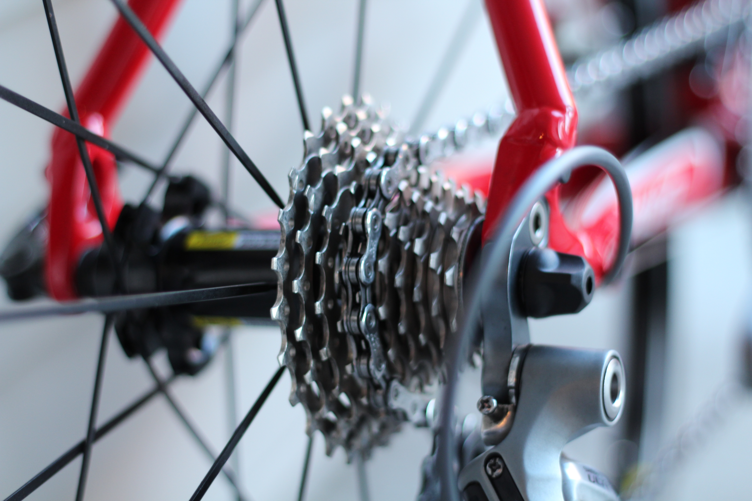


BIKEGEAR SOLUTIONS
Board of Directors Performance Review
Where the business is performing - and where it is not
$94.5M
1,332,077
$41.8M
44.3%
TOTAL REVENUE
ORDER QUANTITY
TOTAL PROFIT
PROFIT MARGIN
Reporting period: FY2011 - FY2016 | Prepared for the Board | May 2026

Slide 2
Executive Summary
Performing vs non-performing segments - benchmark: above/below average
TOTAL REVENUE
ORDER QUANTITY
TOTAL PROFIT
$94.5M
1,332,077
$41.8M
Across 6 countries
Units sold globally
44.3% margin
PERFORMANCE LEDGER
Dimension | Segments | Performing (above avg) | Non-Performing (below avg) | Benchmark Revenue
By Country | 6 | 2 | 4 | $15.7M
By State | 53 | 12 | 41 | $1.8M
By Age Group | 3 | 2 | 1 | $31.5M
HEADLINE
US and Australia drive ~59% of revenue. 41 of 53 states sit below the state average - the long tail is the biggest underperforming bloc.
BikeGear Solutions | Board Pack | Confidential

Slide 3
Performance by Country - Total Revenue
Performing (>= avg) shown in olive; Non-Performing (< avg) shown in brick. Benchmark = $15.7M
CLASSIFICATION
PERFORMING
United States
$30.6M
Australia
$25.3M
NON-PERFORMING
United Kingdom
$11.0M
Germany
$9.9M
France
$9.8M
Canada
$8.0M
BikeGear Solutions | Board Pack | Confidential

Slide 4
Performance by Country - Order Quantity
Performing (>= avg) shown in olive; Non-Performing (< avg) shown in brick. Benchmark = 222,013
CLASSIFICATION
PERFORMING
United States
473,316
Australia
261,110
NON-PERFORMING
Canada
189,751
United Kingdom
155,731
France
127,703
Germany
124,466
BikeGear Solutions | Board Pack | Confidential

Slide 5
Performance by Country - Total Profit
Performing (>= avg) shown in olive; Non-Performing (< avg) shown in brick. Benchmark = $7.0M
CLASSIFICATION
PERFORMING
United States
$13.8M
Australia
$10.8M
NON-PERFORMING
United Kingdom
$4.8M
Germany
$4.3M
France
$4.3M
Canada
$3.8M
BikeGear Solutions | Board Pack | Confidential

Slide 6
Performance by Age Group - Total Revenue
Youth (<25), Young Adult (25-35), Adult (>35). Benchmark = $31.5M
ADULT
PERFORMING
$43.7M
+38.7% vs avg
YOUNG ADULT
PERFORMING
$34.9M
+10.7% vs avg
YOUTH
NON-PERFORMING
$16.0M
-49.3% vs avg
BikeGear Solutions | Board Pack | Confidential

Slide 7
Performance by Age Group - Order Quantity
Youth (<25), Young Adult (25-35), Adult (>35). Benchmark = 444,026
ADULT
PERFORMING
629,059
+41.7% vs avg
YOUNG ADULT
PERFORMING
455,616
+2.6% vs avg
YOUTH
NON-PERFORMING
247,402
-44.3% vs avg
BikeGear Solutions | Board Pack | Confidential

Slide 8
Performance by Age Group - Total Profit
Youth (<25), Young Adult (25-35), Adult (>35). Benchmark = $13.9M
ADULT
PERFORMING
$19.5M
+39.8% vs avg
YOUNG ADULT
PERFORMING
$15.3M
+9.6% vs avg
YOUTH
NON-PERFORMING
$7.1M
-49.4% vs avg
BikeGear Solutions | Board Pack | Confidential

Slide 9
Performance by State - Total Revenue
Top 10 Performing vs Bottom 10 Non-Performing states / regions
TOP 10 PERFORMING
BOTTOM 10 NON-PERFORMING
BikeGear Solutions | Board Pack | Confidential

Slide 10
States - Performing vs Non-Performing Snapshot
All three KPIs side-by-side for the extremes
TOP 5 PERFORMING STATES
BOTTOM 5 NON-PERFORMING STATES
State | Revenue | Qty | Profit
California | $17.9M | 267,440 | $8.1M
England | $11.0M | 155,731 | $4.8M
New South Wales | $10.5M | 114,897 | $4.5M
Washington | $8.6M | 136,756 | $3.9M
British Columbia | $7.9M | 189,124 | $3.8M
State | Revenue | Qty | Profit
Alabama | $210 | 105 | $105
North Carolina | $465 | 63 | $279
Ontario | $1,215 | 116 | $768
Virginia | $1,485 | 63 | $930
South Carolina | $1,514 | 117 | $794
THE GAP IS STARK
California generated $17.9M in revenue - roughly 4,287x more than Kentucky ($4,172).
12 of 53 states sit above the state average, leaving 41 in the long tail. The board should decide whether to consolidate distribution or fund targeted growth investments in the lowest-performing regions.
BikeGear Solutions | Board Pack | Confidential

Slide 11


Best & Worst Selling Products
By units sold across the full FY2011-FY2016 period
BEST SELLER (BY UNITS)
WORST SELLER (BY UNITS)
Water Bottle - 30 oz.
Mountain-500 Black, 52
161,960 units
40 units
Revenue: $809,800 Profit: $485,880
Revenue: $21,600 Profit: $9,800
TOP 10 BEST SELLERS
BOTTOM 10 WORST SELLERS
BikeGear Solutions | Board Pack | Confidential

Slide 12
Product Mix - Sub-Category Performance
Volume leader's vs revenue leaders. Bikes drive revenue; consumables drive volume.
BY UNITS SOLD
BY REVENUE
BikeGear Solutions | Board Pack | Confidential

Slide 13
Sales Seasonality - When We Sell, When We Don't
Monthly pattern across all years. Peak season = above average; off season = below average.
PEAK MONTH
TROUGH MONTH
AVG MONTHLY UNITS
AVG MONTHLY REVENUE
December
July
111,006
$7.87M
December peaks (~22% above avg) on gift season; July dips ~21% below avg. Stock up for May-June cycling season.
BikeGear Solutions | Board Pack | Confidential

Slide 14
States - Performing vs Non-Performing Snapshot
All three KPIs side-by-side for the extremes
TOP 5 PERFORMING STATES
BOTTOM 5 NON-PERFORMING STATES
State | Revenue | Qty | Profit
California | $17.9M | 267,440 | $8.1M
England | $11.0M | 155,731 | $4.8M
New South Wales | $10.5M | 114,897 | $4.5M
Washington | $8.6M | 136,756 | $3.9M
British Columbia | $7.9M | 189,124 | $3.8M
State | Revenue | Qty | Profit
Alabama | $210 | 105 | $105
North Carolina | $465 | 63 | $279
Ontario | $1,215 | 116 | $768
Virginia | $1,485 | 63 | $930
South Carolina | $1,514 | 117 | $794
THE GAP IS STARK
California generated $17.9M in revenue - roughly 4,287x more than Kentucky ($4,172).
12 of 53 states sit above the state average, leaving 41 in the long tail. The board should decide whether to consolidate distribution or fund targeted growth investments in the lowest-performing regions.
BikeGear Solutions | Board Pack | Confidential

Slide 15
BOARD RECOMMENDATIONS
Where to defend, where to invest, where to retreat
DEFEND
Strongholds - US & Australia, California & England, Adult segment
These deliver 59% of revenue and the deepest profit pool. Maintain ad-spend, protect inventory, lock in loyalty programs.
GROW
Investment zones - UK, Germany, France, Canada, Young Adult segment
Below-average country revenue but proven channels exist. Reallocate marketing from saturated leaders to fund regional campaigns.
REVIEW
Long tail - 41 underperforming states, Youth segment
Decide between consolidating fulfilment, partnering with local distributors, or sunsetting unprofitable SKUs. Run a Youth-focused acquisition pilot to test demand.
Prepared by Analytics | Source: BikeGear Solutions sales data, FY2011-FY2016

